Slide 1


Slide 2
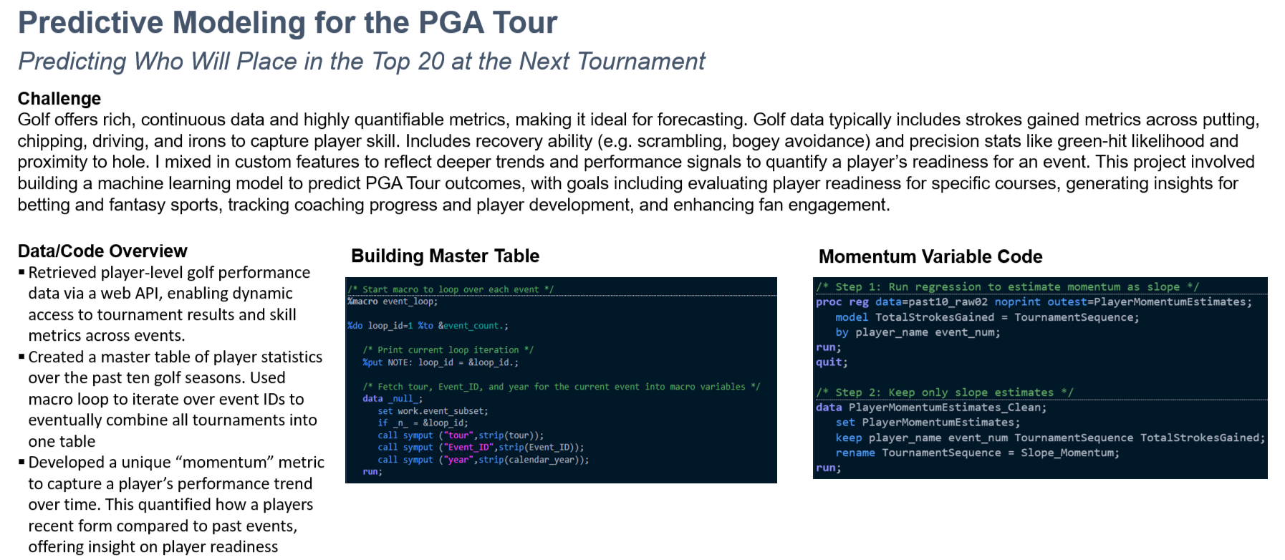

Slide 3
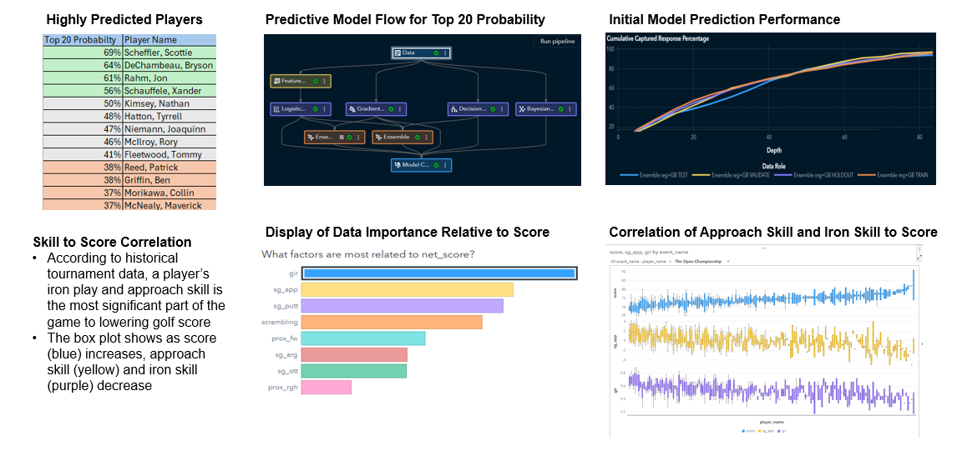
Model Results
My British Open model outperformed industry predictions, with 50% of top-ranked picks landing in the top 20 and 85% making the cut
Roughly 10% higher accuracy than betting sites and pro-grade systems.
Iron Skill
Approach
Putting
Recovery
Approach Result
Chipping
Driver
Approach from Rough

